Slide 1
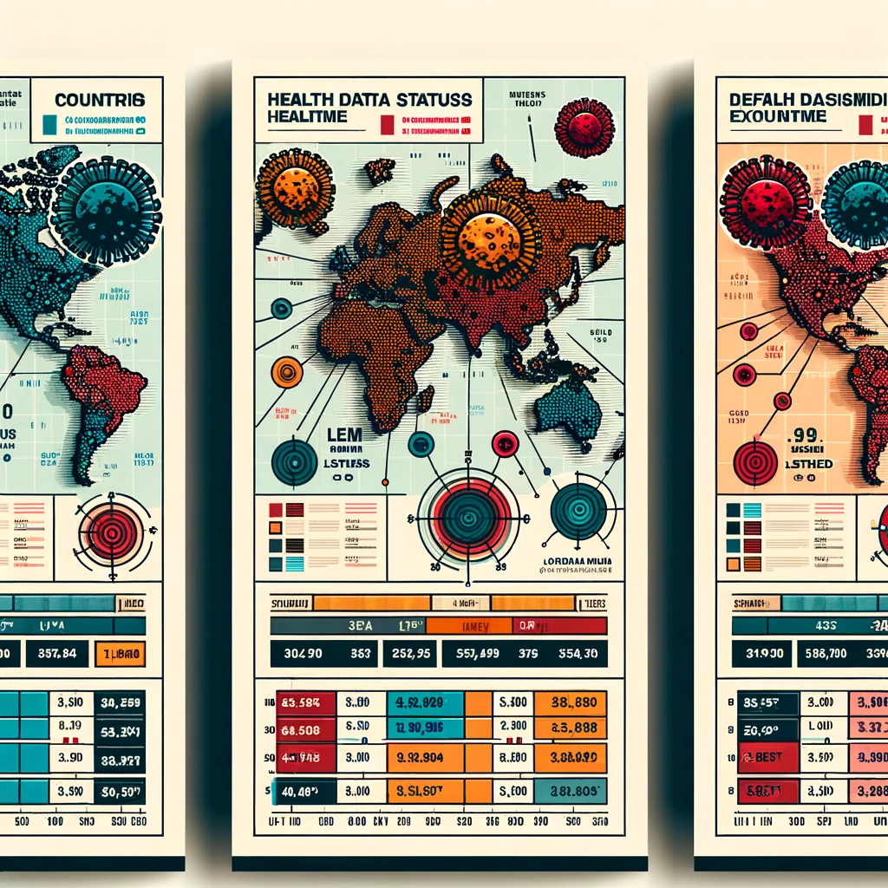

SQL Problem Statement
Mentorness Internship Program
Project 1 – Corona Virus Analysis
Project by: Maria de Fatima Pinto
Batch – MIP-DA-07

Slide 2

Content
Introduction
Dataset Overview
Data Analysis and Data Exploration
Key Findings
Conclusion

Slide 3


Introduction
Covid-19, caused by the SARS-CoV-2 virus, emerged in late 2019, swiftly escalating into a global pandemic. Its unparalleled transmissibility disrupted lives, economies, and health systems worldwide. Despite devastating impacts, collaborative efforts led to scientific breakthroughs, vaccines, and lessons for future preparedness, highlighting humanity's resilience amidst crisis.
As a data analyst, I scrutinized the Covid-19 dataset to uncover significant insights and convey my findings effectively.

Slide 4
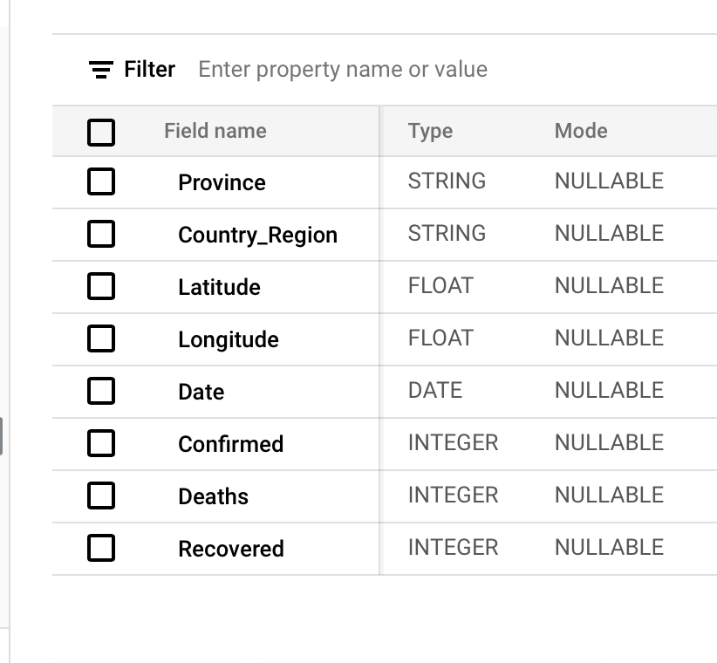
Dataset Overview
Territorial division or administrative region within a country
Refers to a specific geographical area
Geographical coordinate that specifies the north-south position
Geographical coordinate that specifies the east-west position

Slide 5
Dataset Overview
Recorded date of COVID-19 data
Number of diagnosed COVID-19 cases
Number of COVID-19 related deaths
Number of recovered COVID-19 cases

Slide 6

Data Exploration and Analysis
Setting up the Database using BigQuery
Data Cleaning
Data Analysis
Answered Question

Slide 7
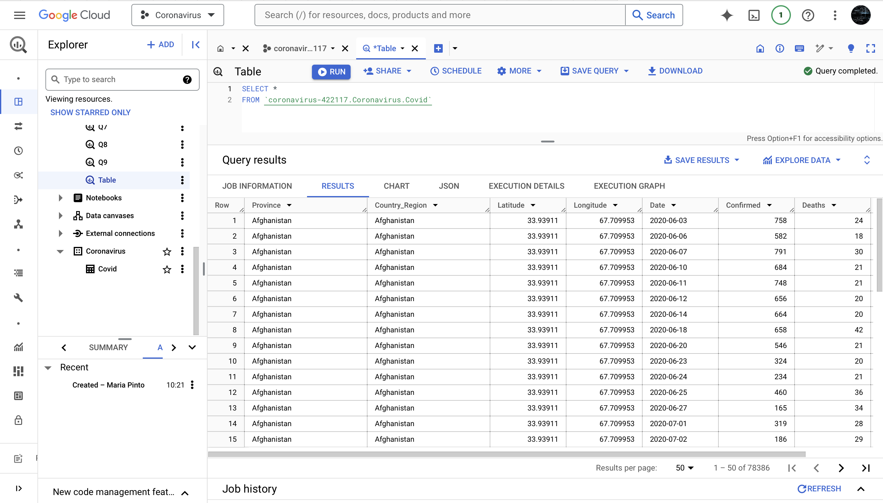

Slide 8

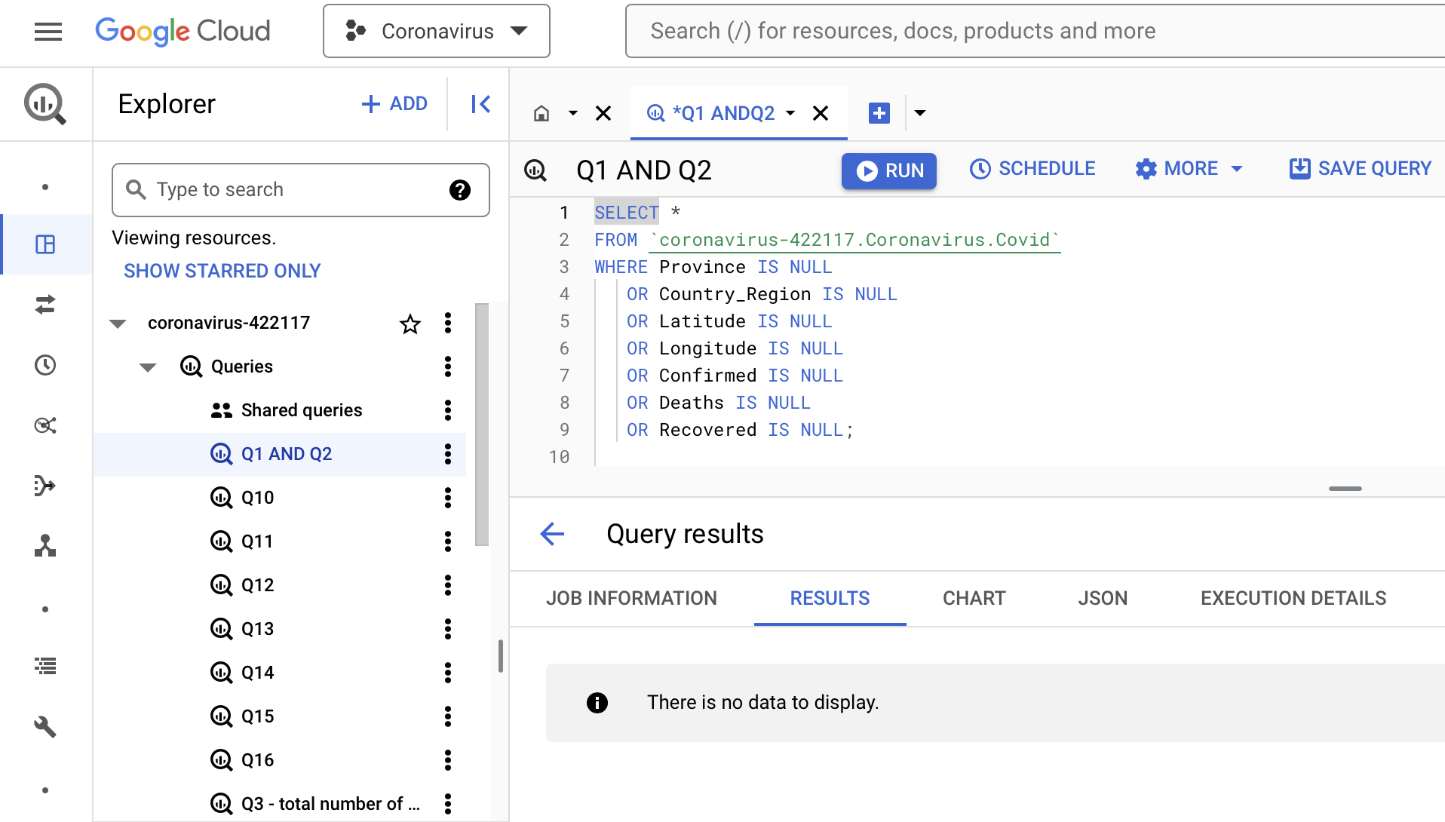
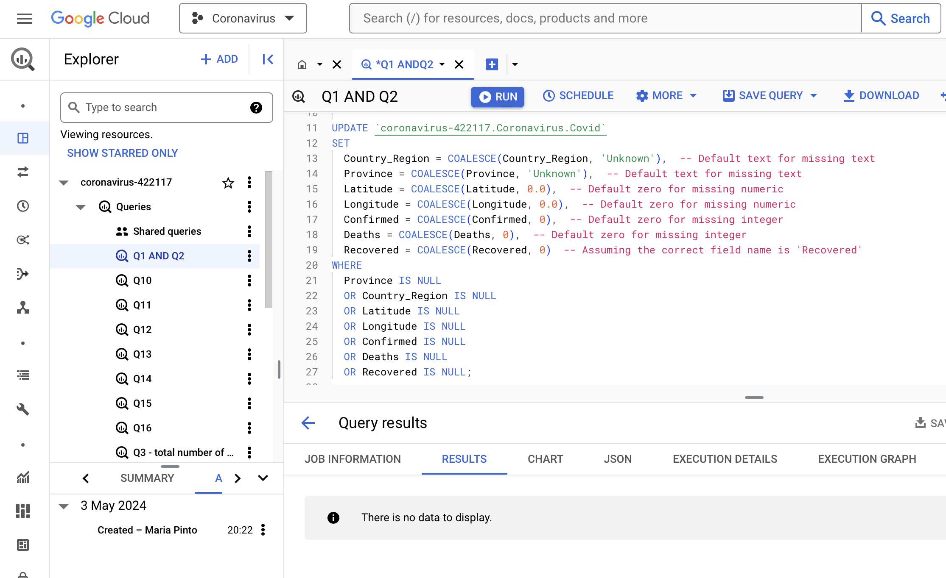
Dataset Cleaning
Checking for NULL Values
Updating NULL Values

Slide 9
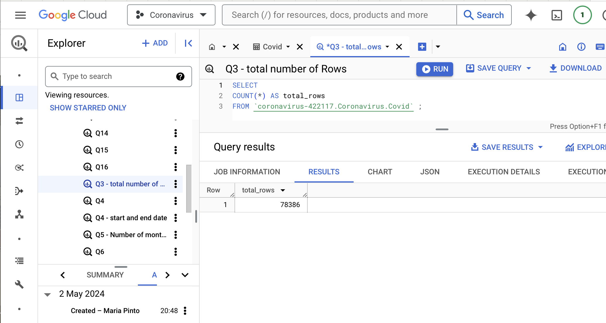
Data Analysis
Total number of Rows in the Covid-19 Dataset
78,386

Slide 10

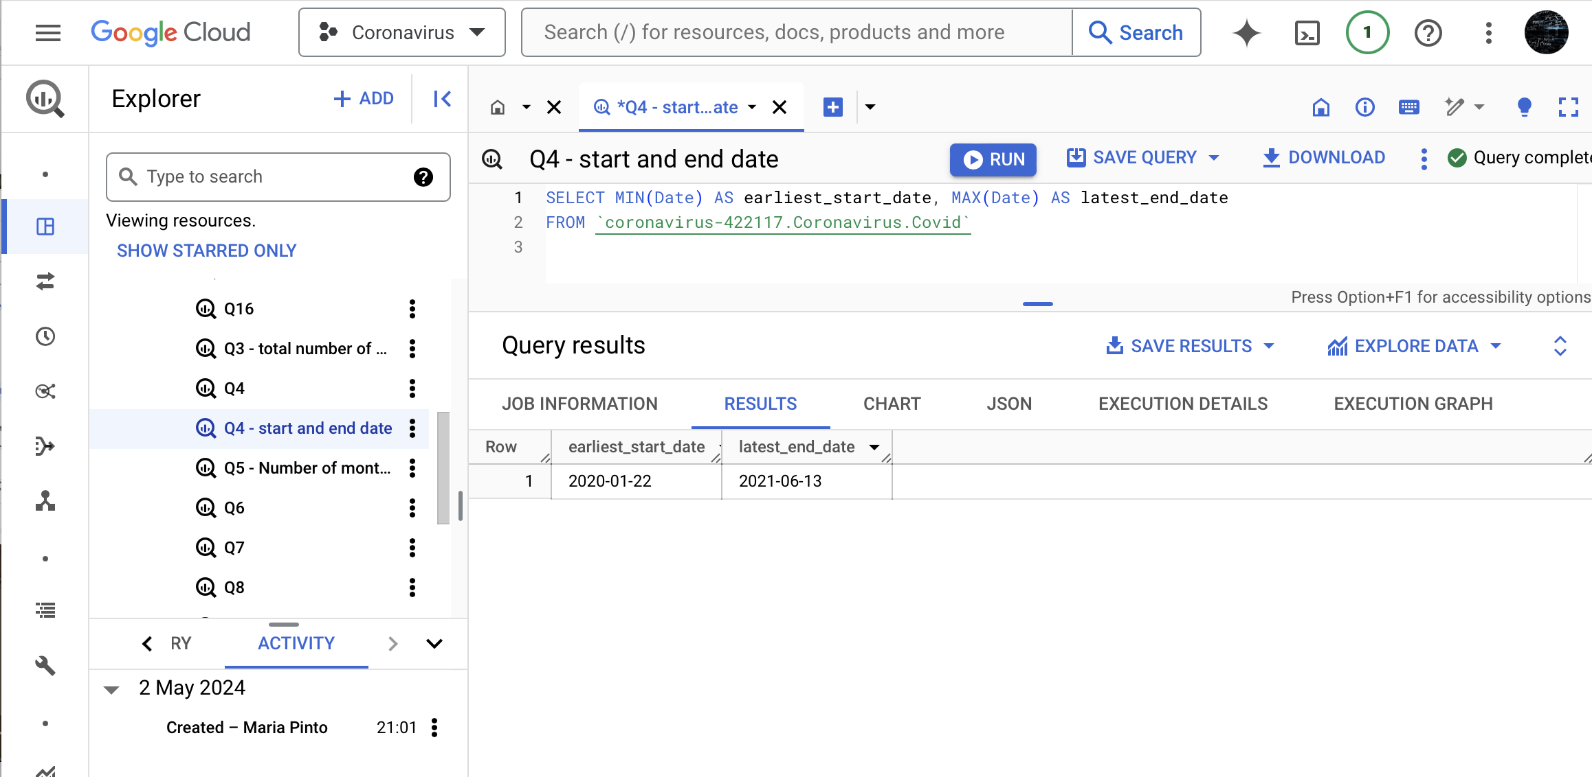
Data Analysis
Start_Date and End_Date
Start_Date 2020-01-22
End_Date 2021-06-13

Slide 11

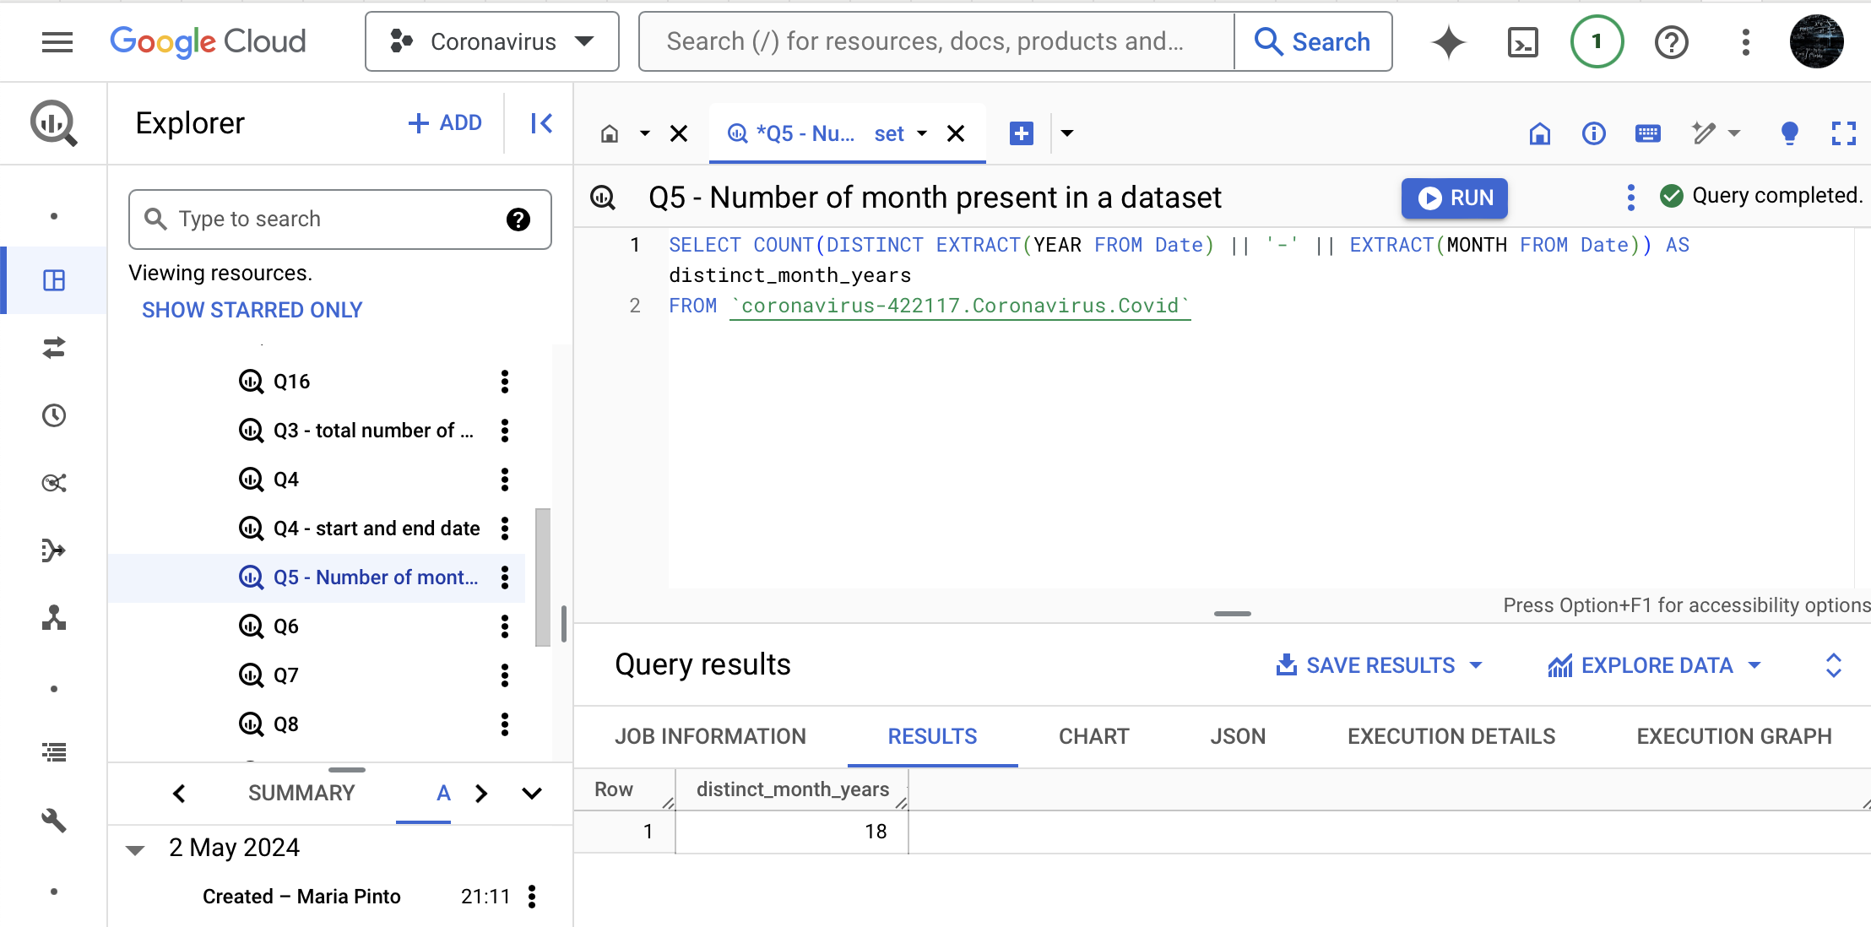
Data Analysis
Number of Months present in dataset – 18 months

Slide 12
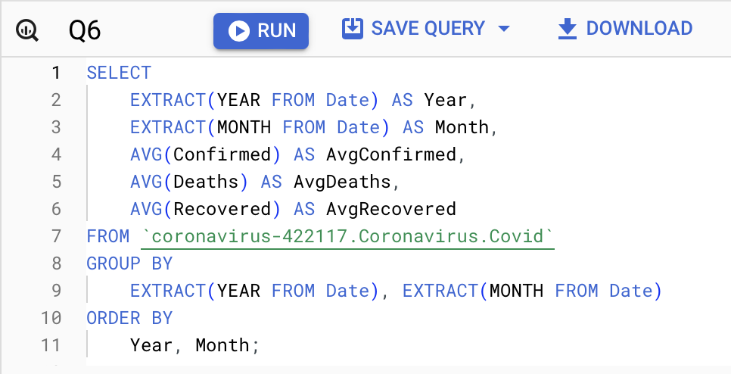
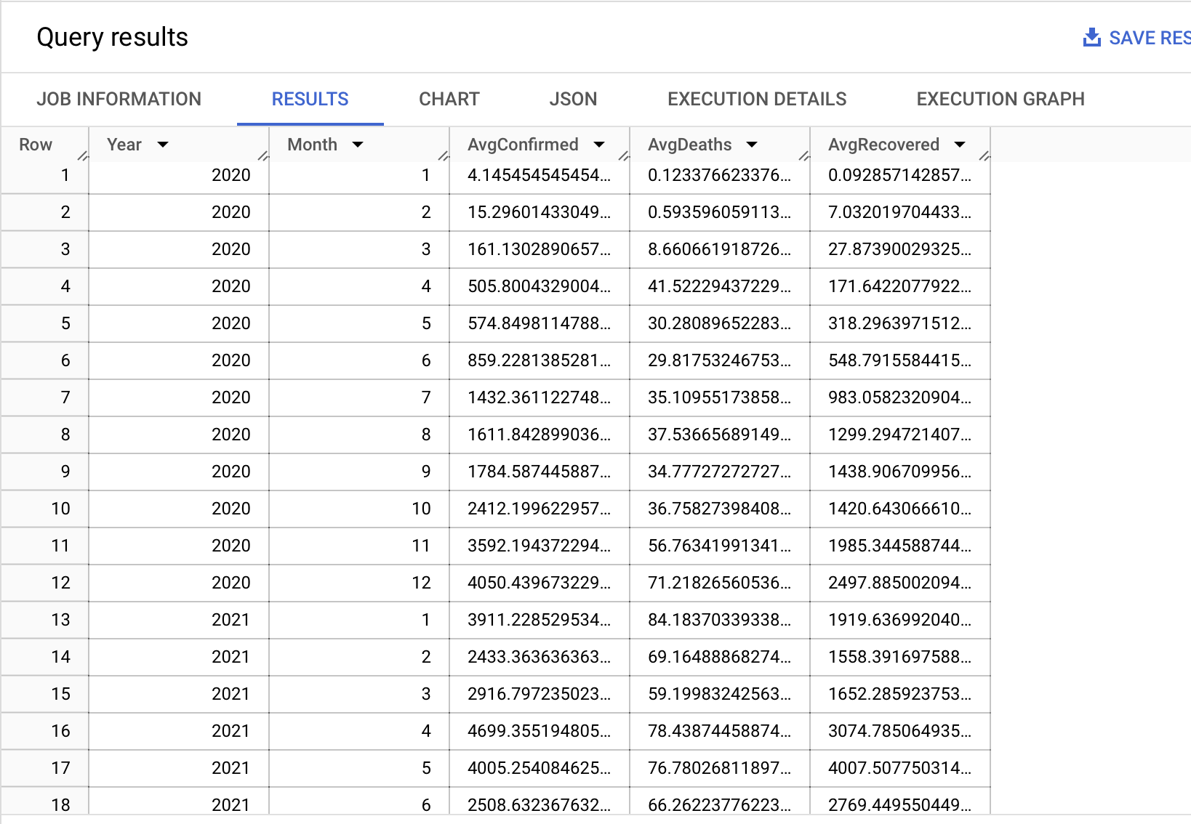
Data Analysis
Monthly Average for Confirmed, Deaths , Recovered

Slide 13
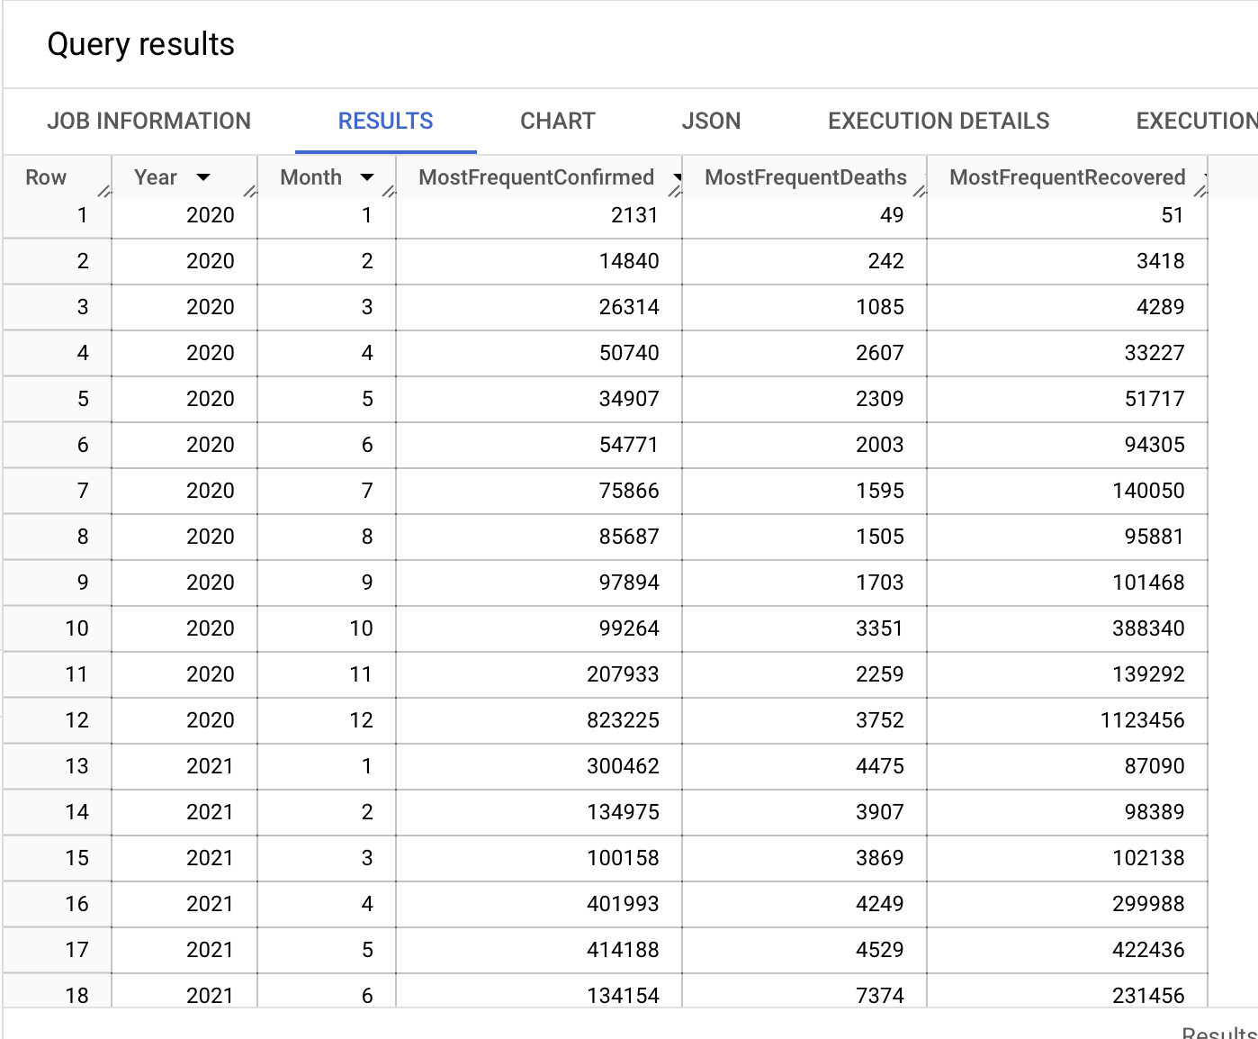
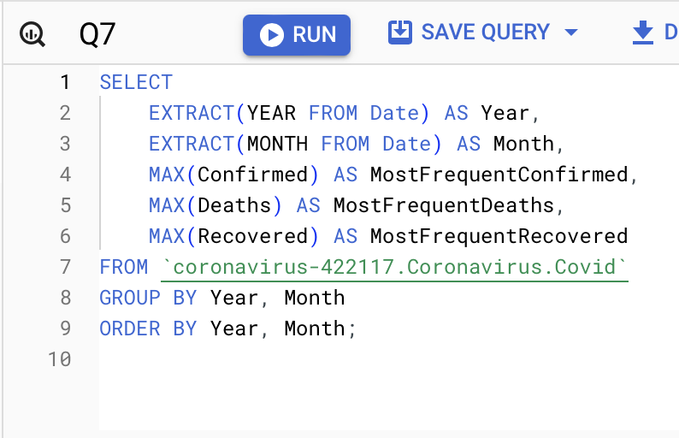
Data Analysis
Most frequent value for confirmed , death, recovered per year

Slide 14
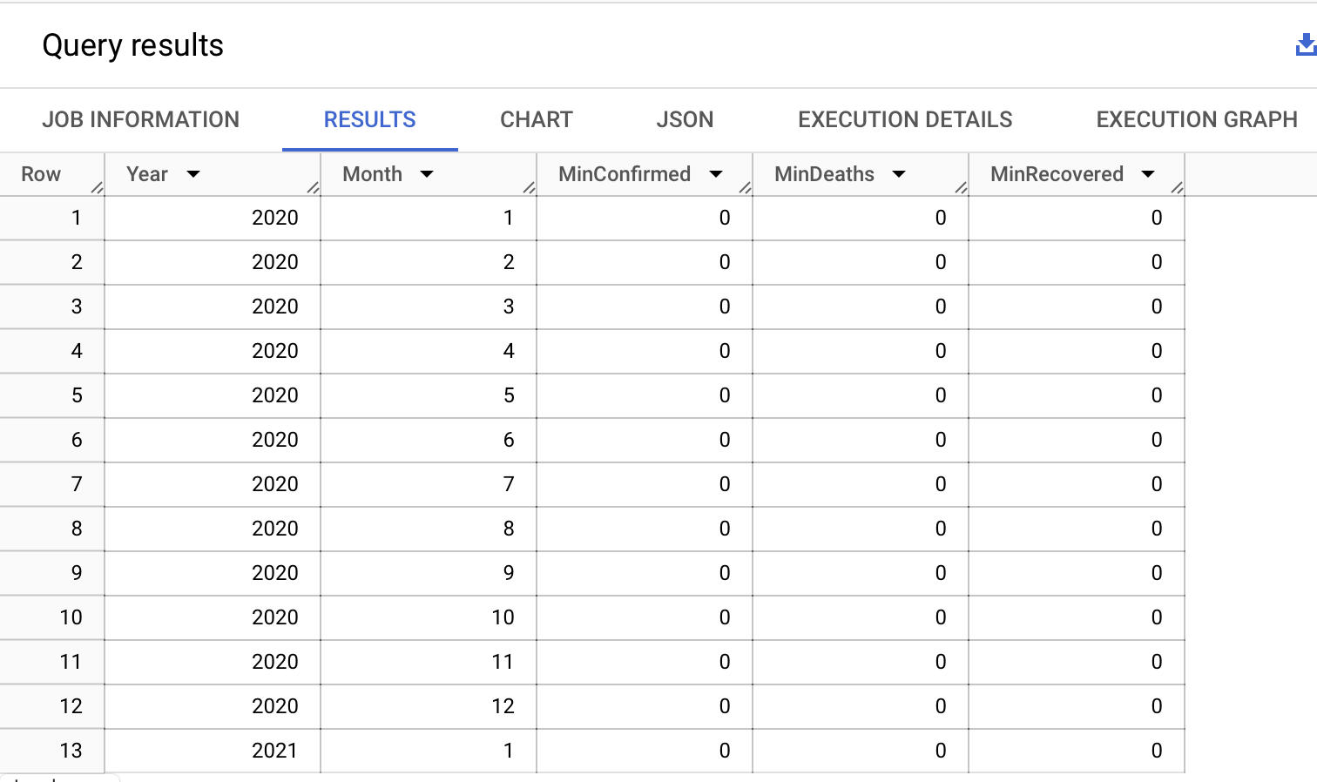
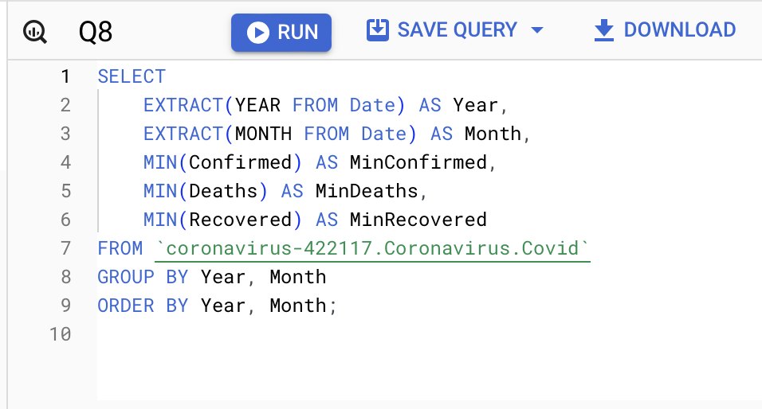
Data Analysis
Minimum value for confirmed , death, recovered per year

Slide 15
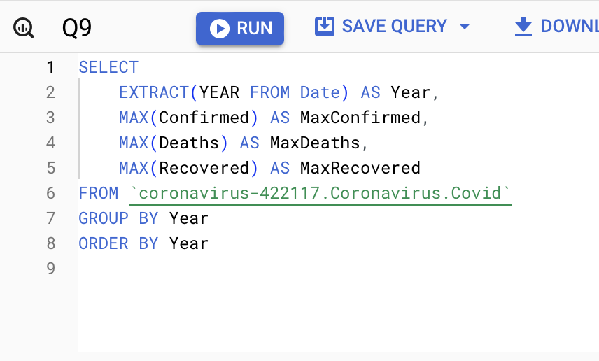
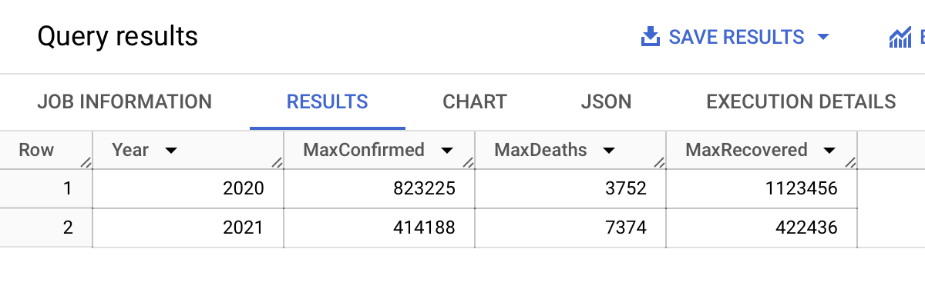
Data Analysis
Maximum value for confirmed , death, recovered per year

Slide 16
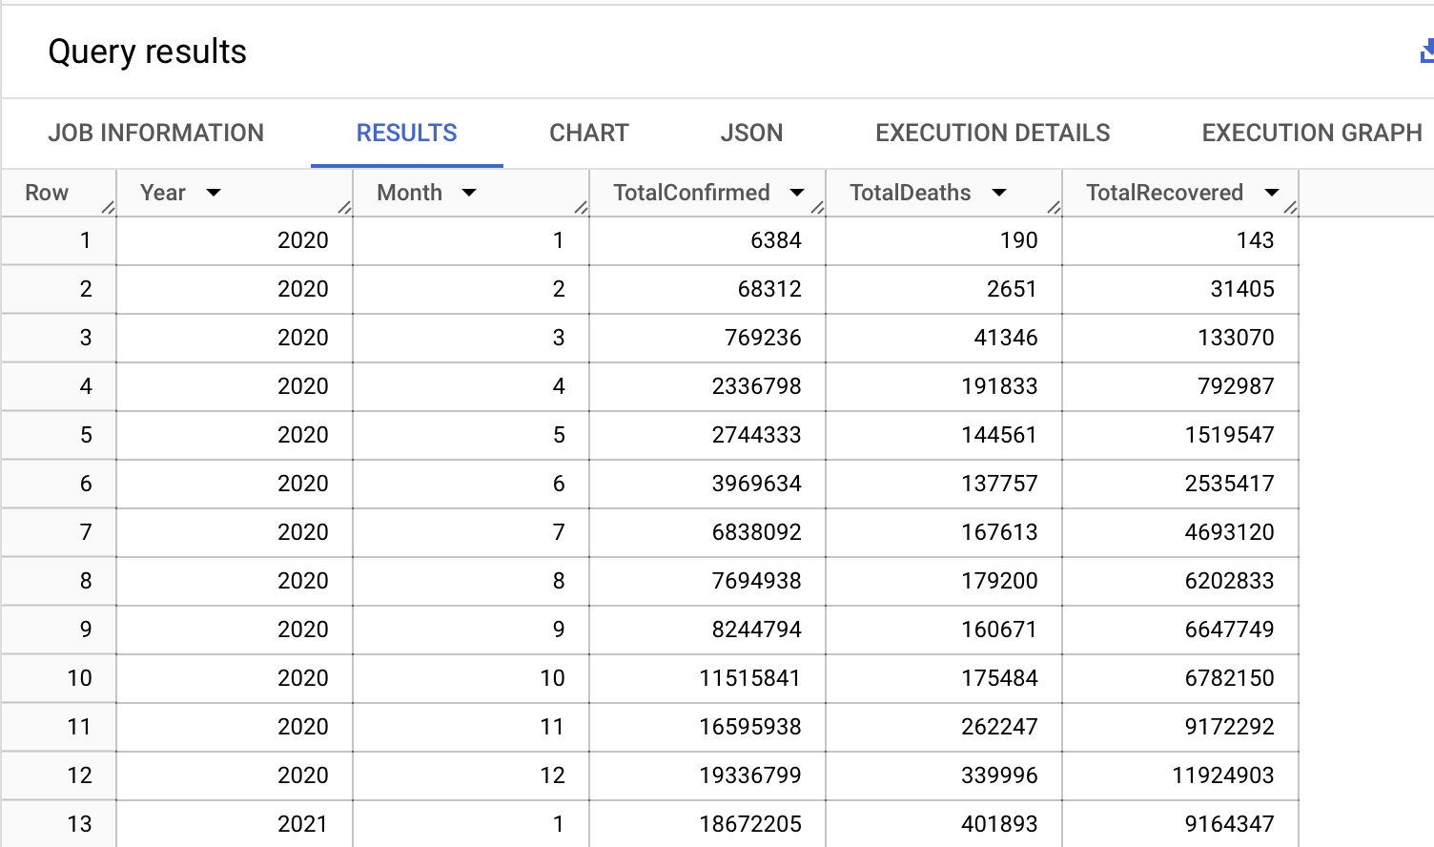
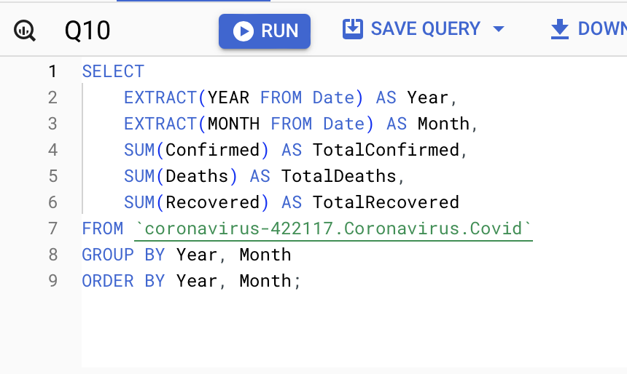
Data Analysis
Total number of case of confirmed , death, recovered per year

Slide 17
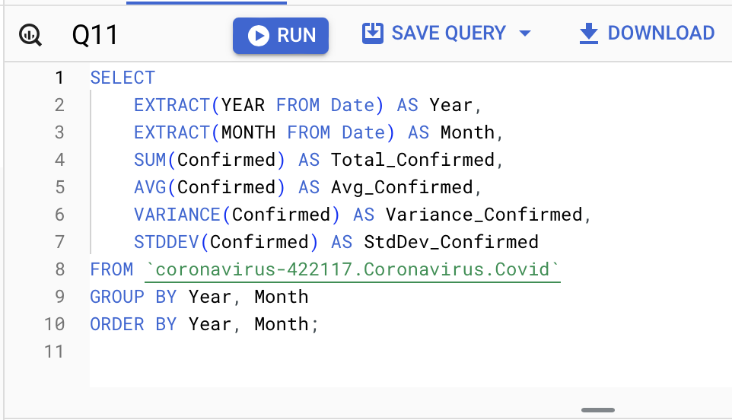
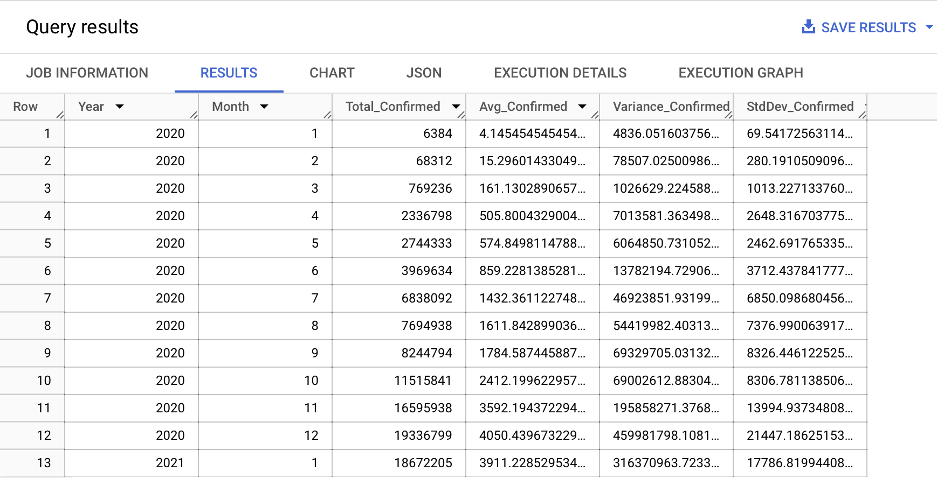
Data Analysis
How the virus spread out with respect to confirmed case

Slide 18
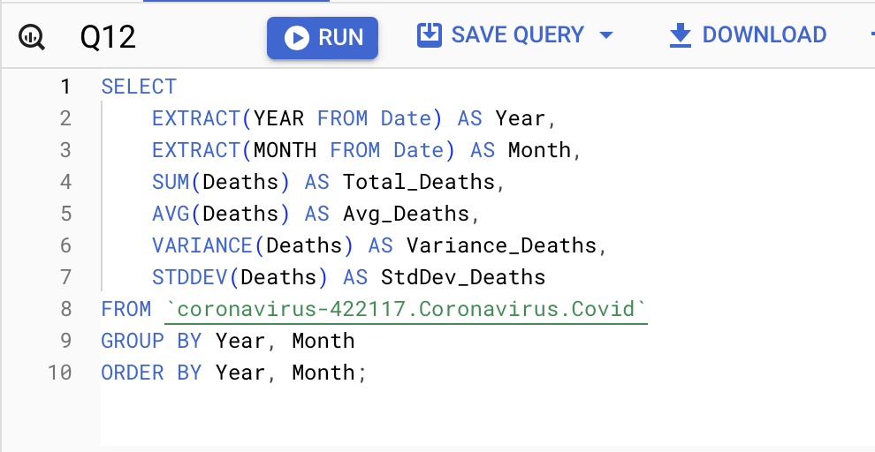
Data Analysis
How the virus spread out with respect to death case per month

Slide 19
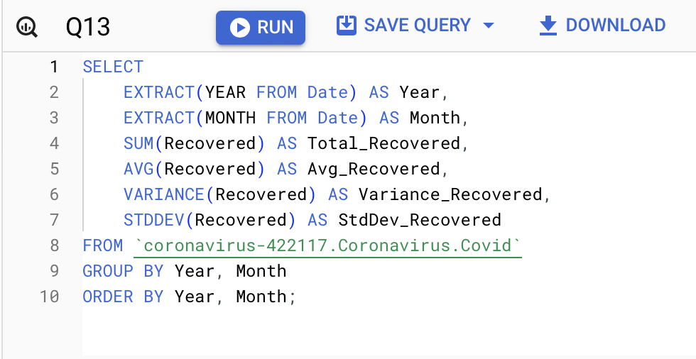
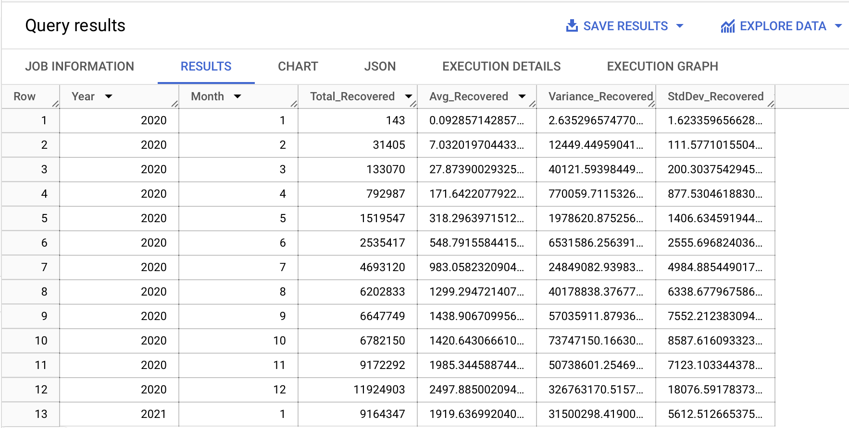
Data Analysis
How the virus spread out with respect to Recovered case per month

Slide 20
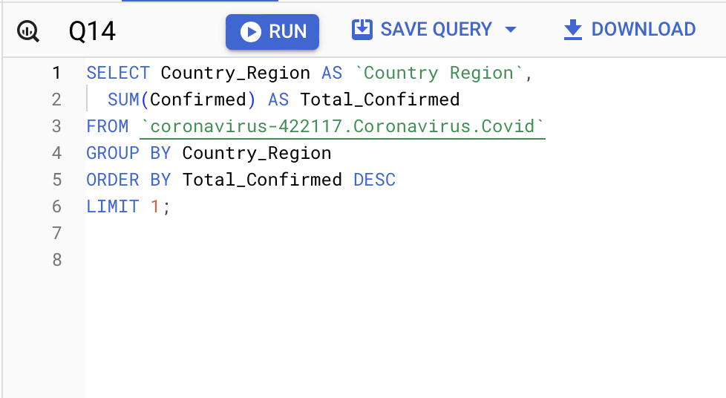
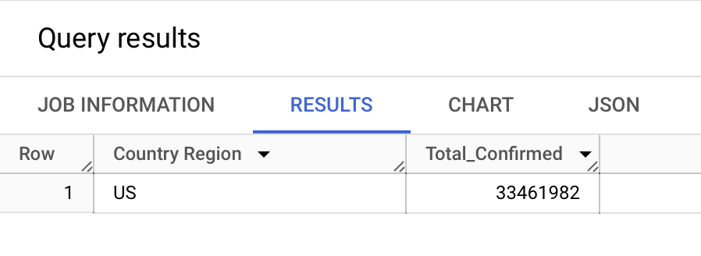
Data Analysis
Country having the highest number of Confirmed cases

Slide 21
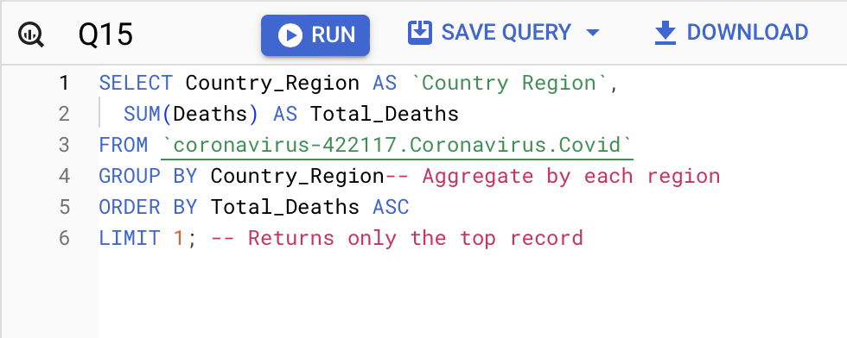
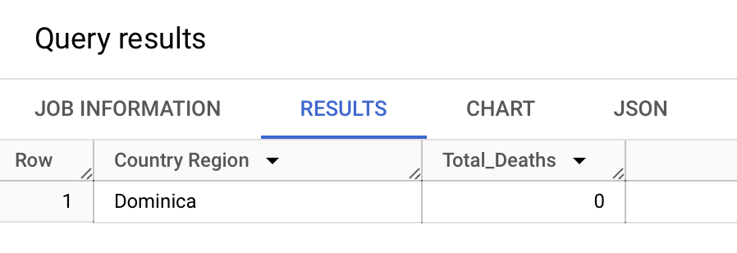
Data Analysis
Country having the lowest number of Confirmed cases

Slide 22
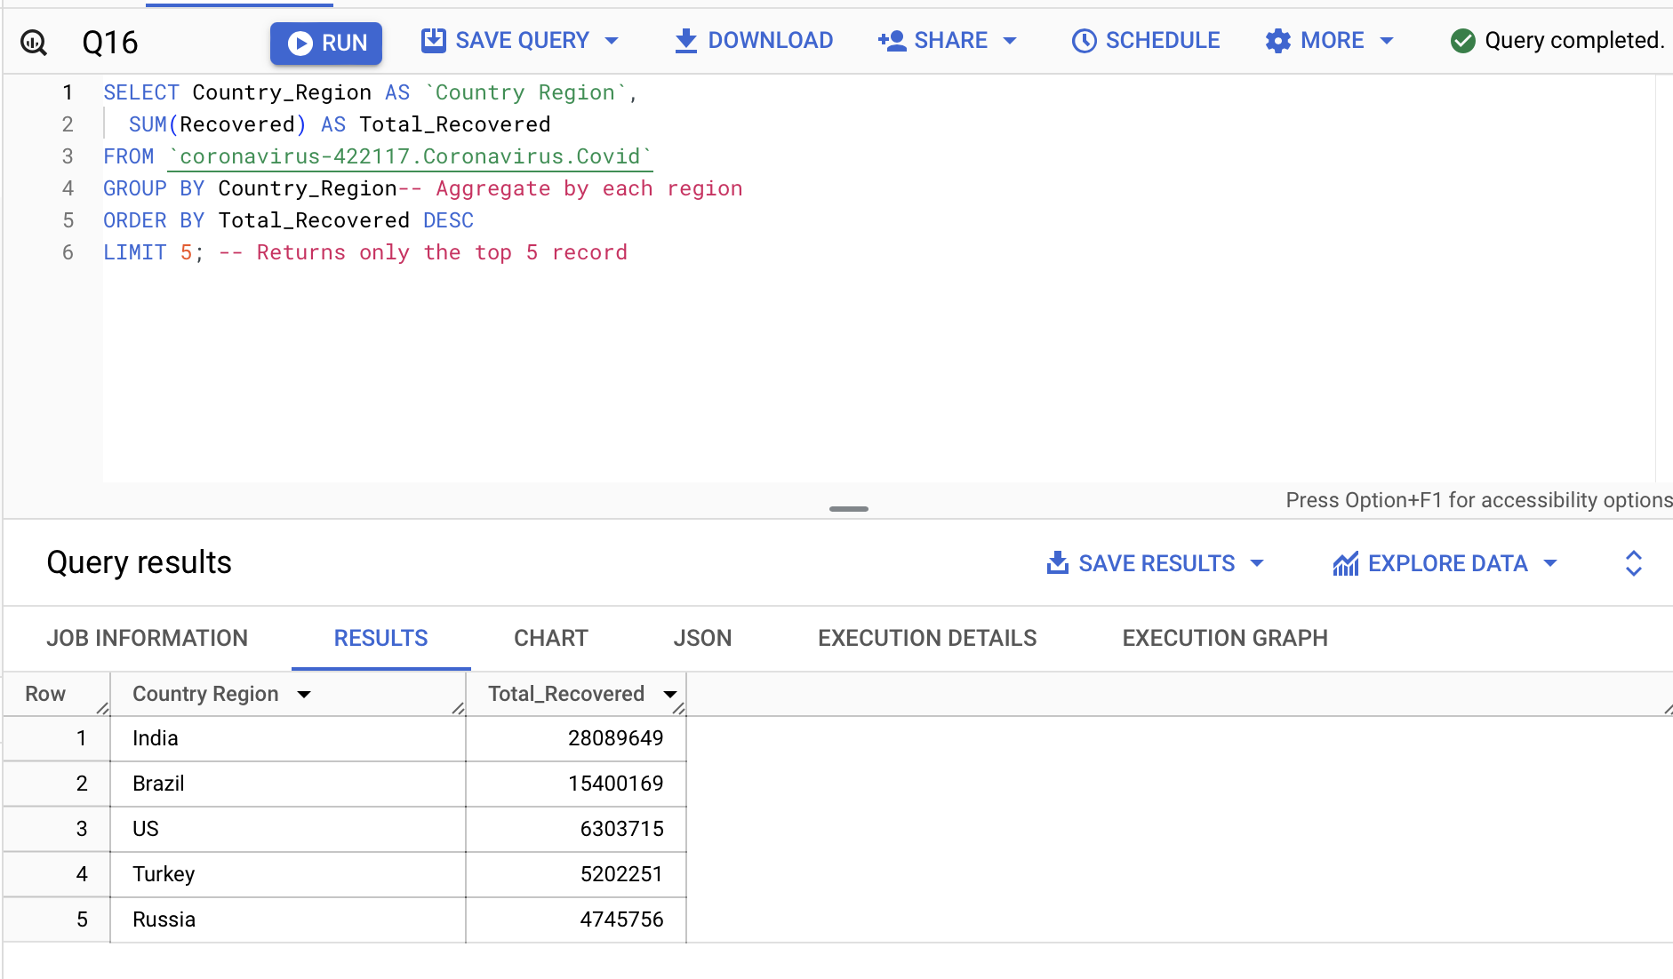
Data Analysis
Top 5 countries having the highest Recovered case

Slide 23

KEY FINDINGS
Statistical Analysis
Temporal Distribution
Trend Analysis
Temporal Granularity
Geographical Detail

Slide 24

CONCLUSION
Thank you!

